Slide 1
POWER BILLING SYSTEM
WEB BASED APPLICATION

Slide 2
INTRODUCTION
In today’s world of emerging technology, computers are playing a vital role in every walk of life. The problems due to the traditional system are overcome with the help of tasks being online. Maintenance of the data like insertion, deletion and modification is difficult with manual systems. The basic option of security is itself not provided which is of major concern. Apart from this, storage of the large amounts of data is difficult. Moreover the problems of consistency, reliability, integrity also exists. Since this is a manual system there is always a probability that there is loss of data, resulting in less durability. As these issues are of major concern, we developed an application were in all the above factors are achieved.

Slide 3
The application basically starts by asking the user to sign in by choosing the CIRCLE-ID & ERO-ID. Later username and password of the employee option is provided. Validating the username and password, the user is directed to the homepage were in he has various options like consumer management, revenue collection, billing and accounting, generating the report. Regarding the modification, constraint is provided wherein the access is limited to the administrator. The statuses of the requests are updated at the earliest. The rectification information will be again updated for the knowledge of the employee. The employee can check the status of the requests before accessing the computer, which will speed up the disposal of the request. Thus, improving the overall efficiency of the organization.

Slide 4
The system accepts data related to Consumers & presents them in the form of reports. These reports are meant for the ERO officers and top management to view details for track performance, generating Due-List, were payments are not done. The System tracks the performance on a daily basis as well as cumulatively over a period of time.
The System captures Information related to actual demand, energy using, payments, etc. from various levels of organization with in the aim of capturing it from as close to the source as possible.
The system helps the user to communicate with the administrator directly which is always expected for establishing a user-friendly environment. It can be used with existing software, so there is no need for any additional software. Thus, making it technically feasible.

Slide 5
  Scope
This application is basically written as a solution to the drawbacks of existing system. This application can be used as a real world application and by any organization. It’s could be used as a general application with few minor modifications.
  Purpose
The purpose of this application is to develop “EBS” (Electronic Billing System), which is a web application which provides a service to all the customers and employees of A.P.S.E.B to deal with the transactions online.

Slide 6
  Problem & Existing technology
In the traditional system files were used to maintain the database which was done manually. This existing system consumes a lot of time. This time consuming evaluation coupled by the huge maintenance problem and may also lead to erroneous results. The various operations performed on these files like sorting, adding, modifying and deletion of the records are very tedious. Moreover these manually maintained files have the possibility of getting worn out. Thus, less durability is achieved.
Thus the demerits of the existing system can be summarized as follows…
There is no consistency as the data may not be updated on time.
Feasibility is reduced
Less reliability
Security is not provided and any one can access
Prioritization of records is difficult.
More erroneous
Difficult to maintain
As every thing is done manually its slow process
No timely acknowledgement service
Taking the demerits into consideration, an alternative system which uses Oracle as both front end and back end was used. In front end, retrieval of the data from the database is done through SQL queries i.e using D2K forms. This is not a web application and the data is not distributed as only a single system is used. As it is confined only to a particular system, scope is limited and there is a hindrance to the reliability if the system fails.
The demerits of this alternate system are…
Only single system used.
If the system crashes then the data is lost
too overburdened
not reliable
slow processing
less flexible
not so user friendly

Slide 7
4 Proposed system
The proposed system is developed based on the client server architecture, a request-response paradigm and is implemented with the help of advanced java using the tomcat web container. The employees can maintain and do the transactions online.
The application starts by asking for user name and password which provides authentication. This system provides high security where the unauthorized users cannot access the data.
Later we have different options for the employee like
Consumer Management
Revenue Collection
Billing and Accounting
Reports
Meter Details
Ledger Process
Journal Details
The objectives of the proposed system are as follows:
Easy to use, effective and efficient
Accurate results.
Easy maintenance.
Fast access
More feasibility
More secure.
Provides high consistency.
More reliable

Slide 8
: REQUIREMENTS
2.1 Functional Requirements
In software engineering, a functional requirement defines a function of a software system or its component. A function is described as a set of inputs, the behavior, and outputs. Functional requirements may be calculations, technical details, data manipulation and processing and other specific functionality that show how a use case is to be fulfilled. They are supported by non-functional requirements, which impose constraints on the design or implementation (such as performance requirements, security, or reliability).As defined in requirements engineering, functional requirements specify particular behaviors of a system. This should be contrasted with non-functional requirements which specify overall characteristics such as cost and reliability.
2.1.2 Modules Description
2.1.2.1 Login

Slide 9
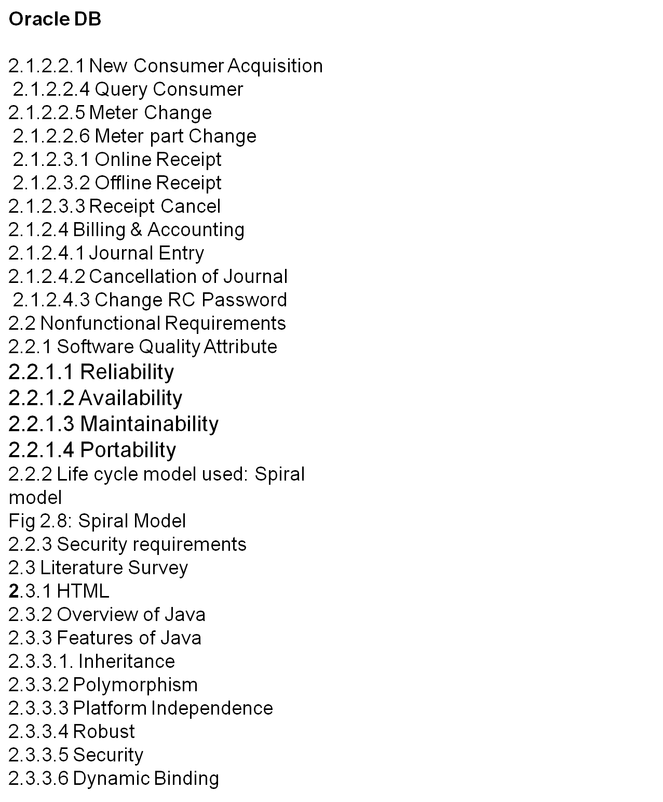

Slide 10
System Requirements Specifications
Hardware Requirements…
Operating system …. Any OS
Processor…………….PIIIMHz or above
RAM…………………..256 MB
Hard Disk…….……….Min.300 MB working space
Key Board…………….101 Standards
Software Requirements…
Languages ............……….JDK1.5, Oracle
Tools ……………….……....Tomcat
Technology …………..…….Java

Slide 11
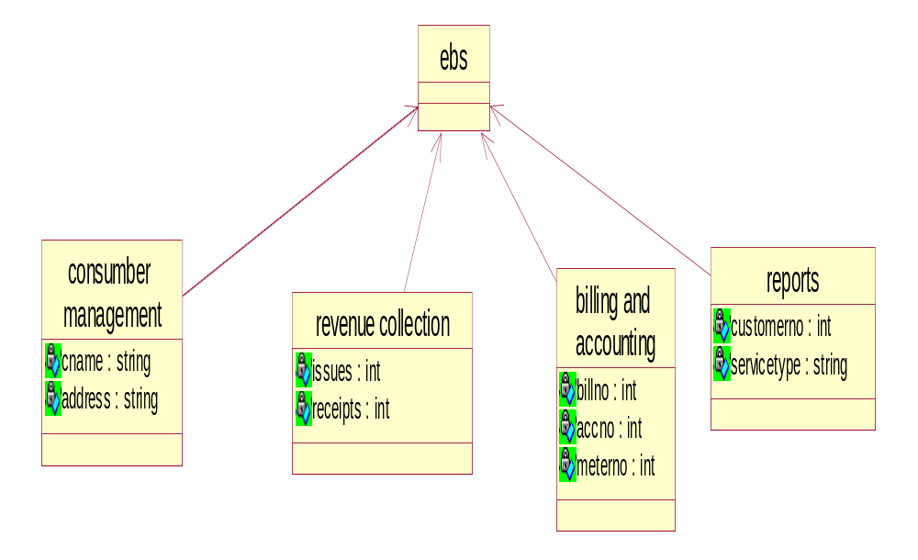
Class Diagram
EBS

Slide 12
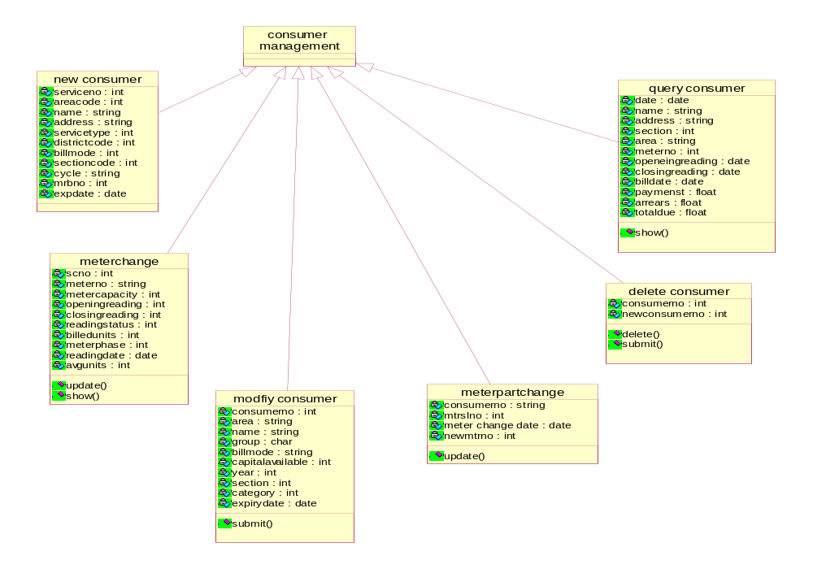
Consumer Management
Fig 4.2.2.2: Class Diagram

Slide 13
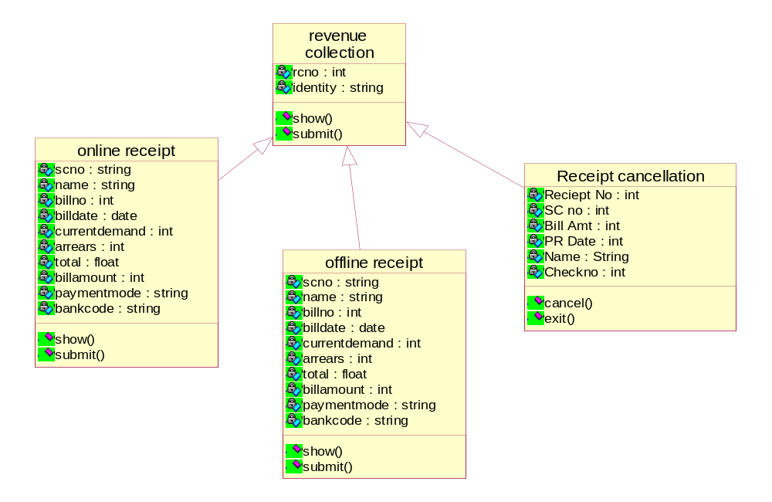
Revenue Collection
Fig 4.2.2.3: Class Diagram

Slide 14
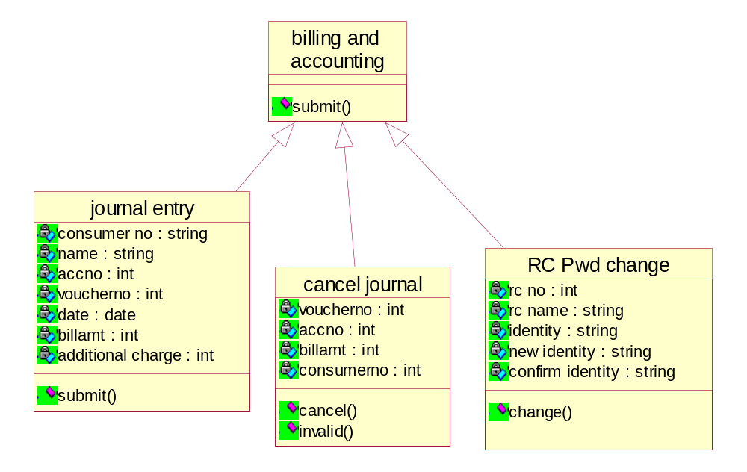
Billing and Accounting
Fig 4.2.2.4: Class Diagram

Slide 15
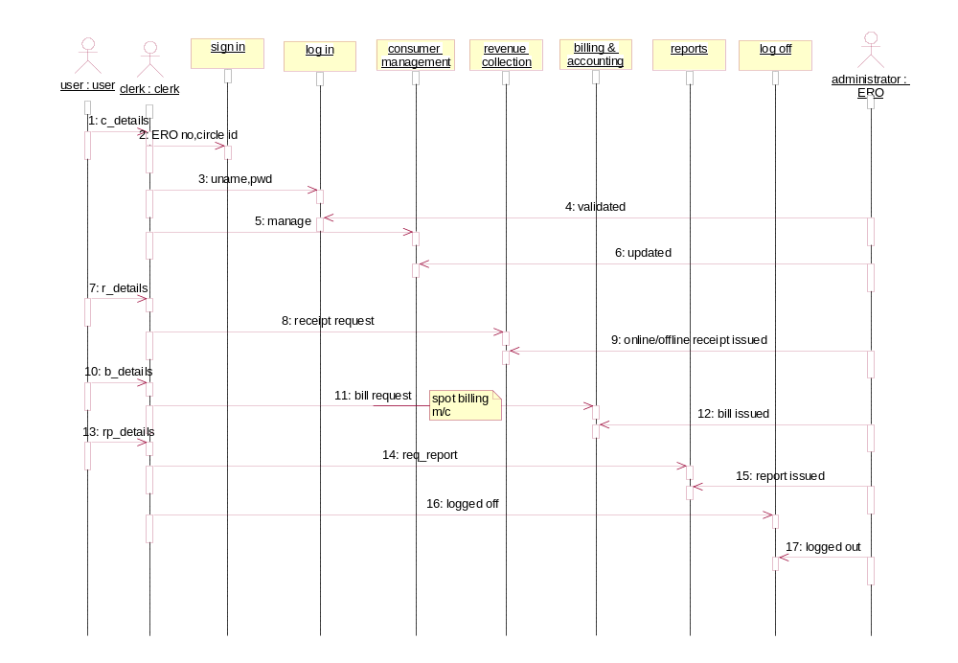
Sequence Diagrams

Slide 16
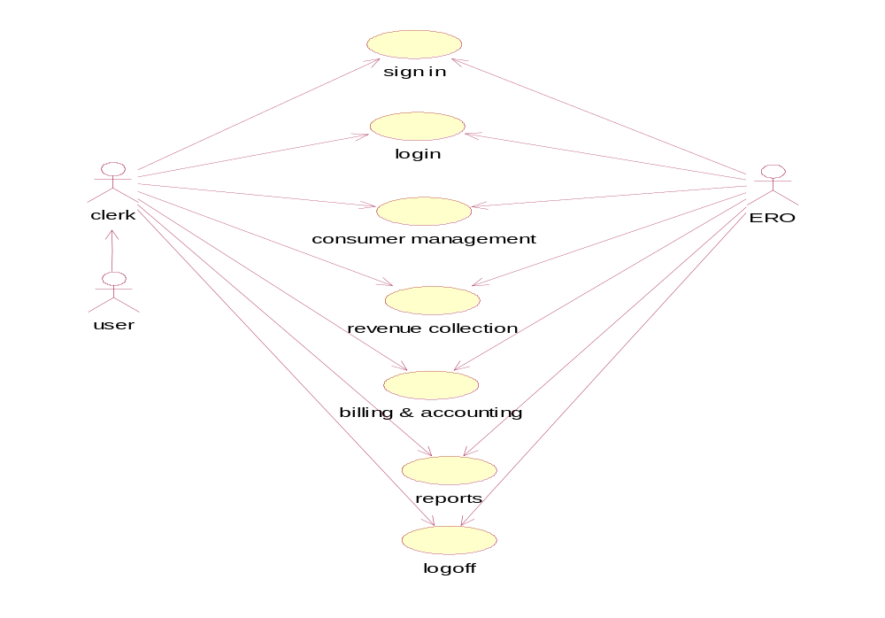
Use Case Diagram
Homepage

Slide 17
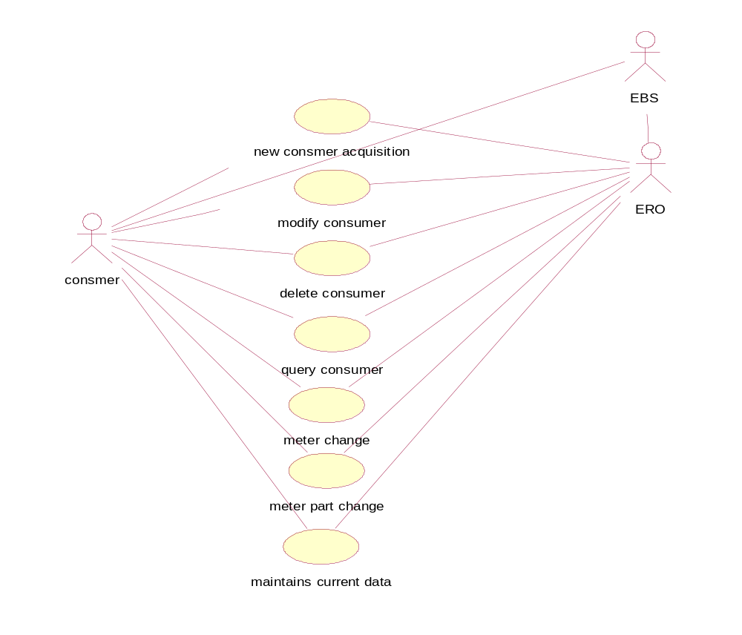
Consumer Management

Slide 18
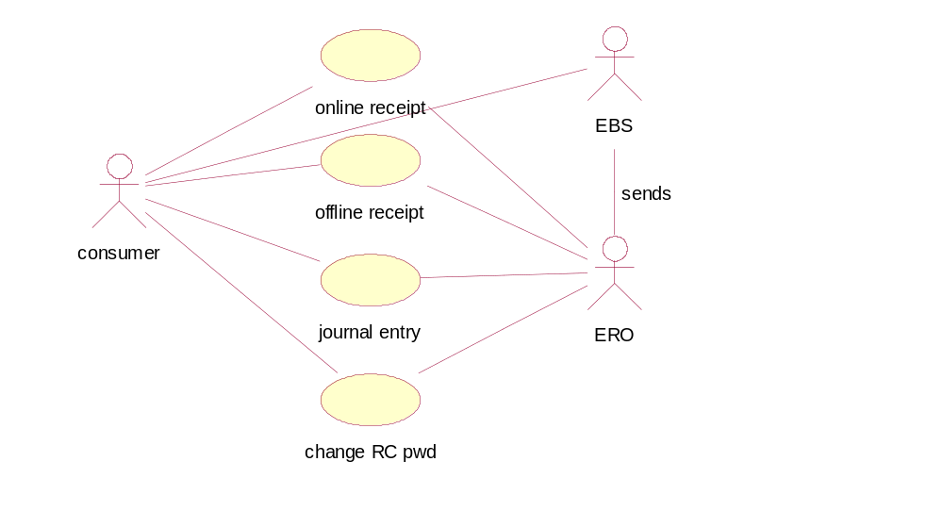
Revenue Collection

Slide 19
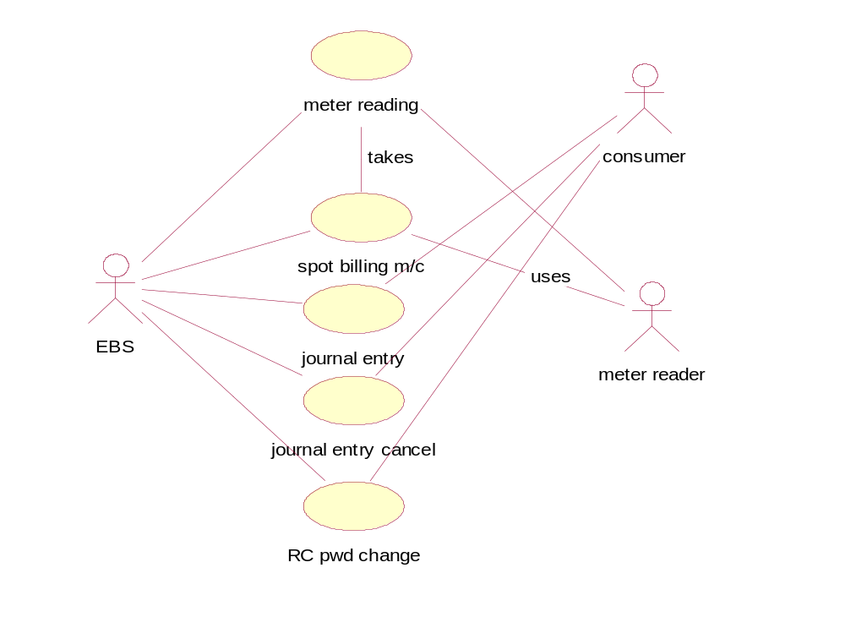
Billing & Accounting

Slide 20
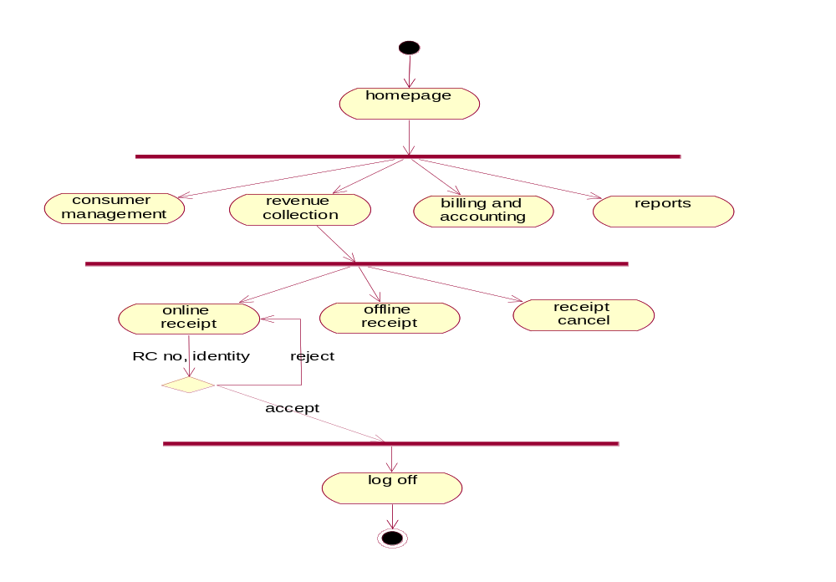
Activity Diagram

Slide 21
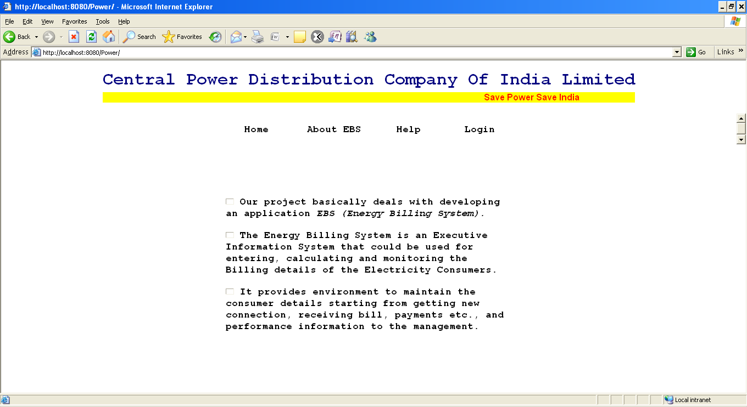
: SCREENS AND REPORTS

Slide 22
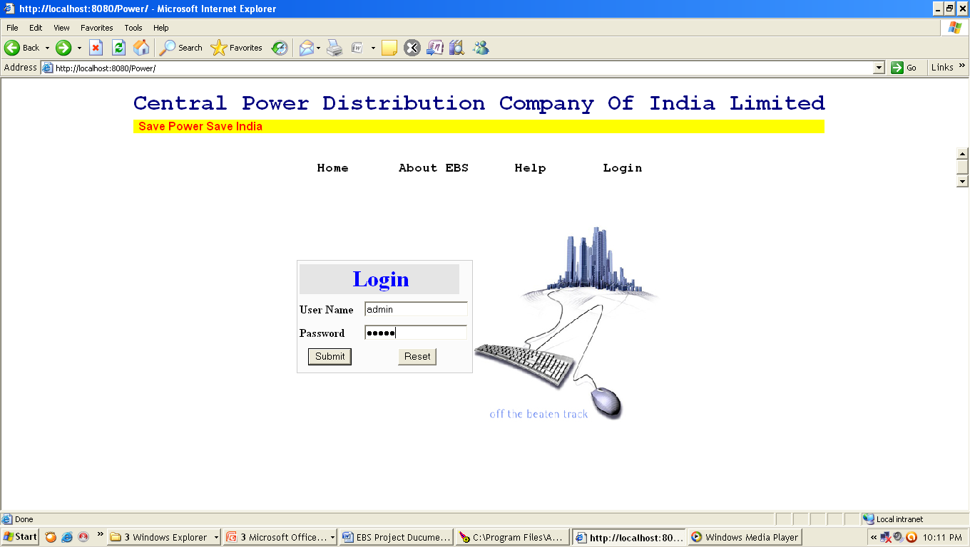

Slide 23
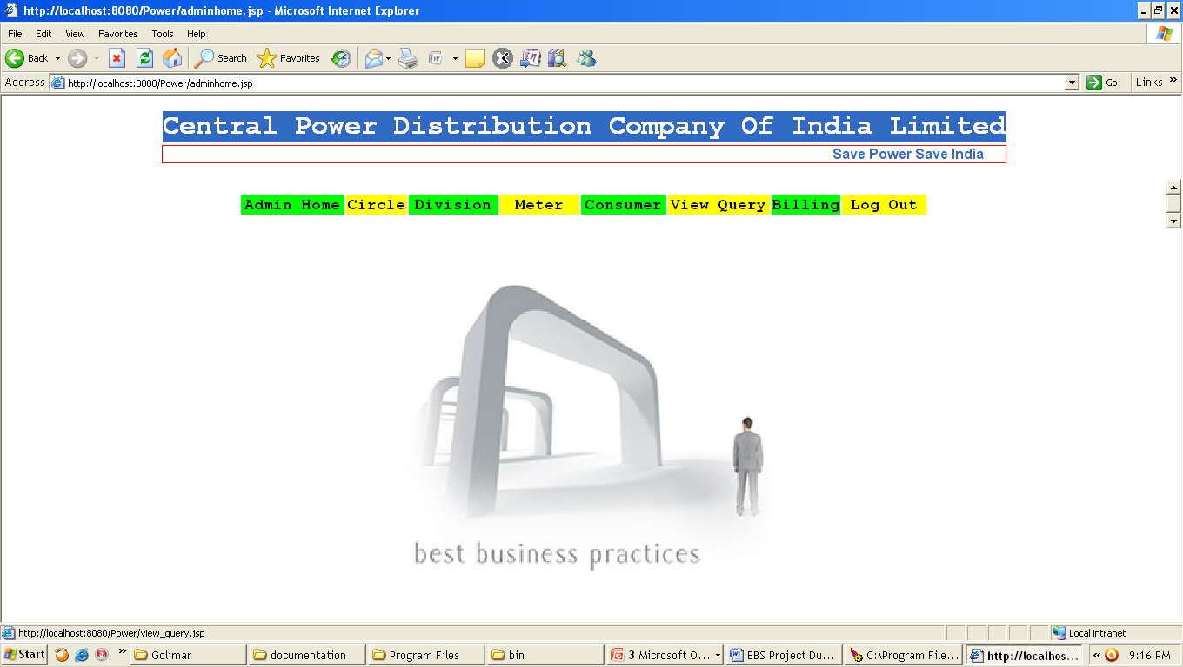

Slide 24
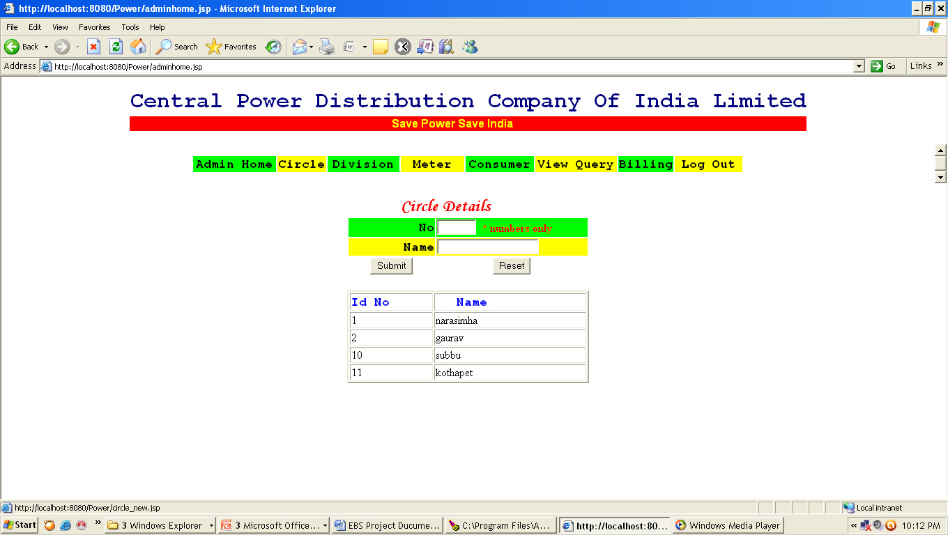

Slide 25
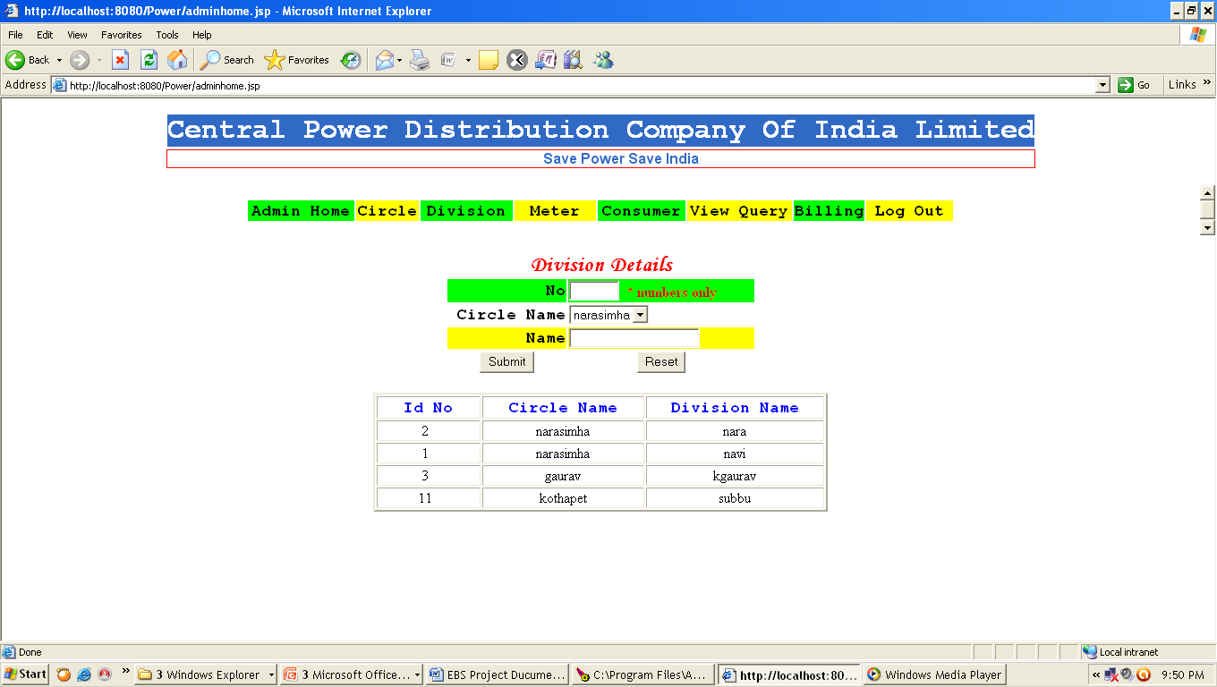

Slide 26
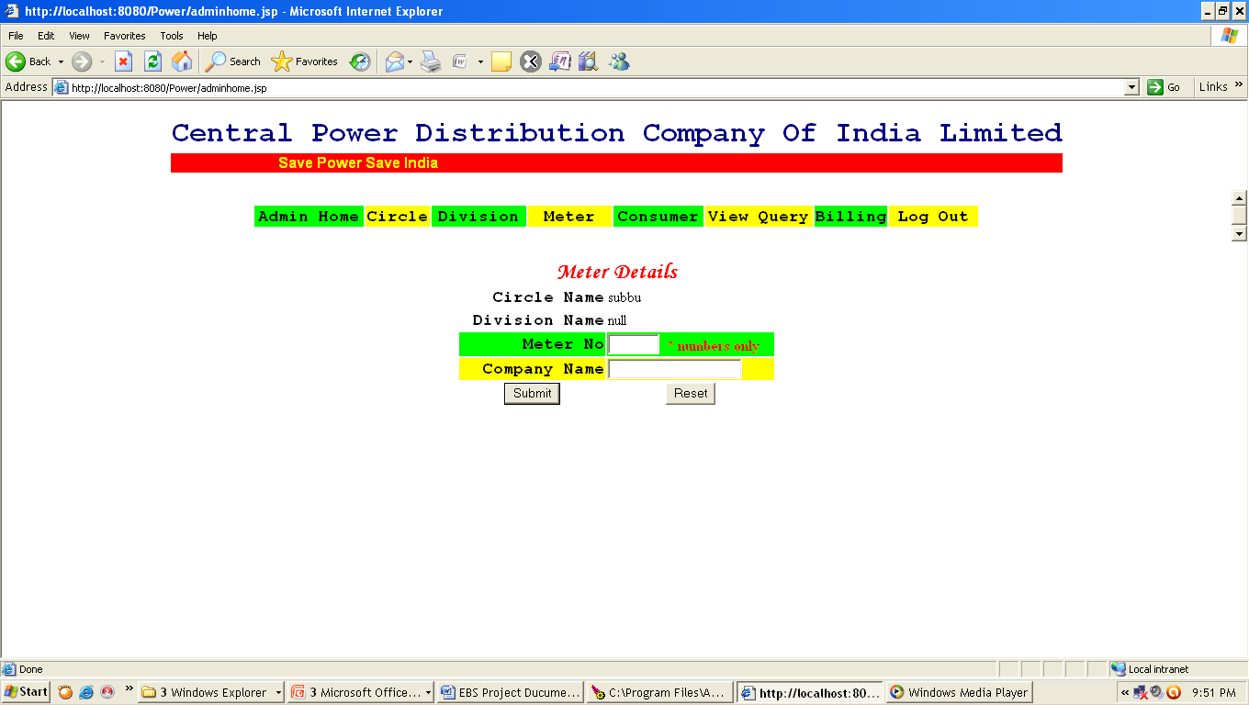

Slide 27
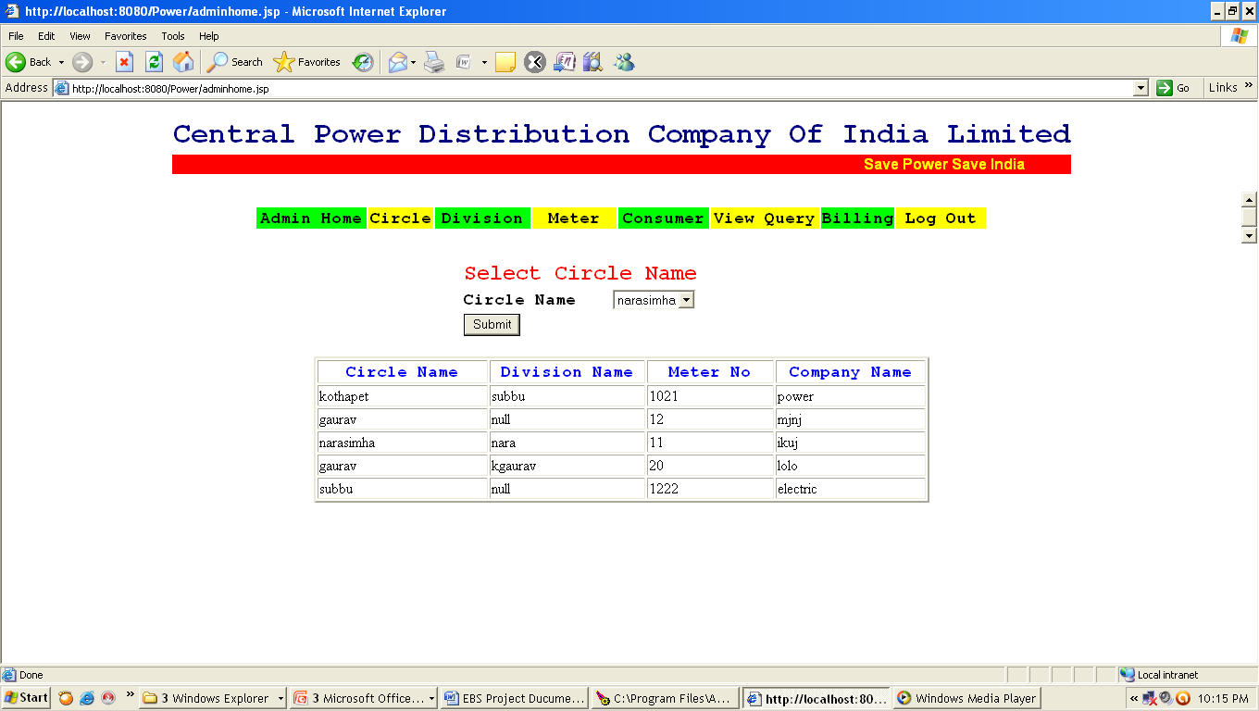

Slide 28
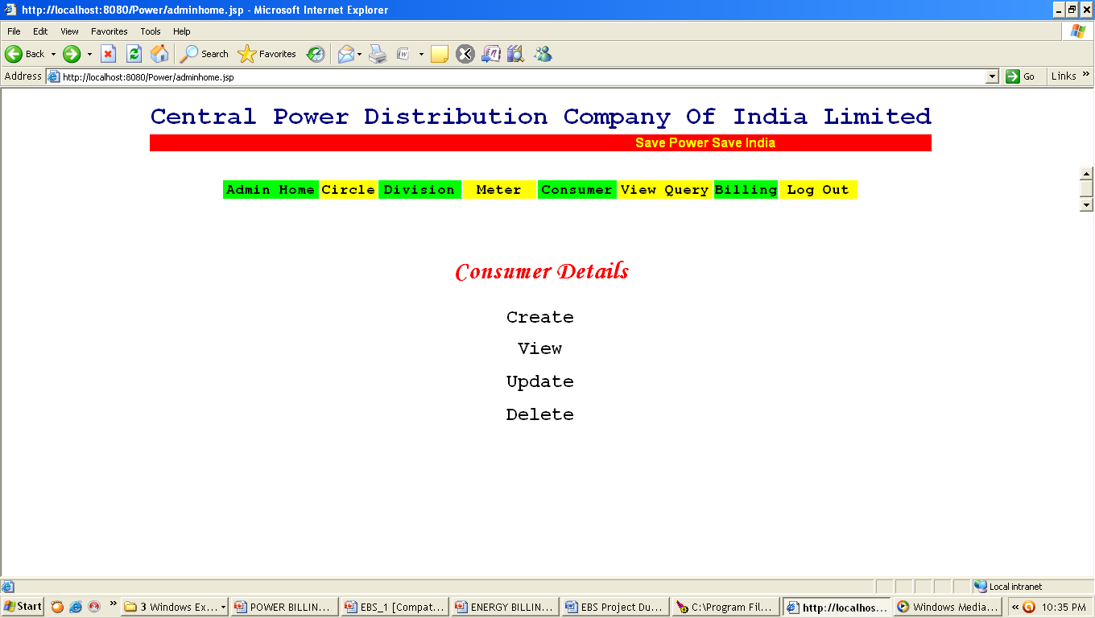

Slide 29
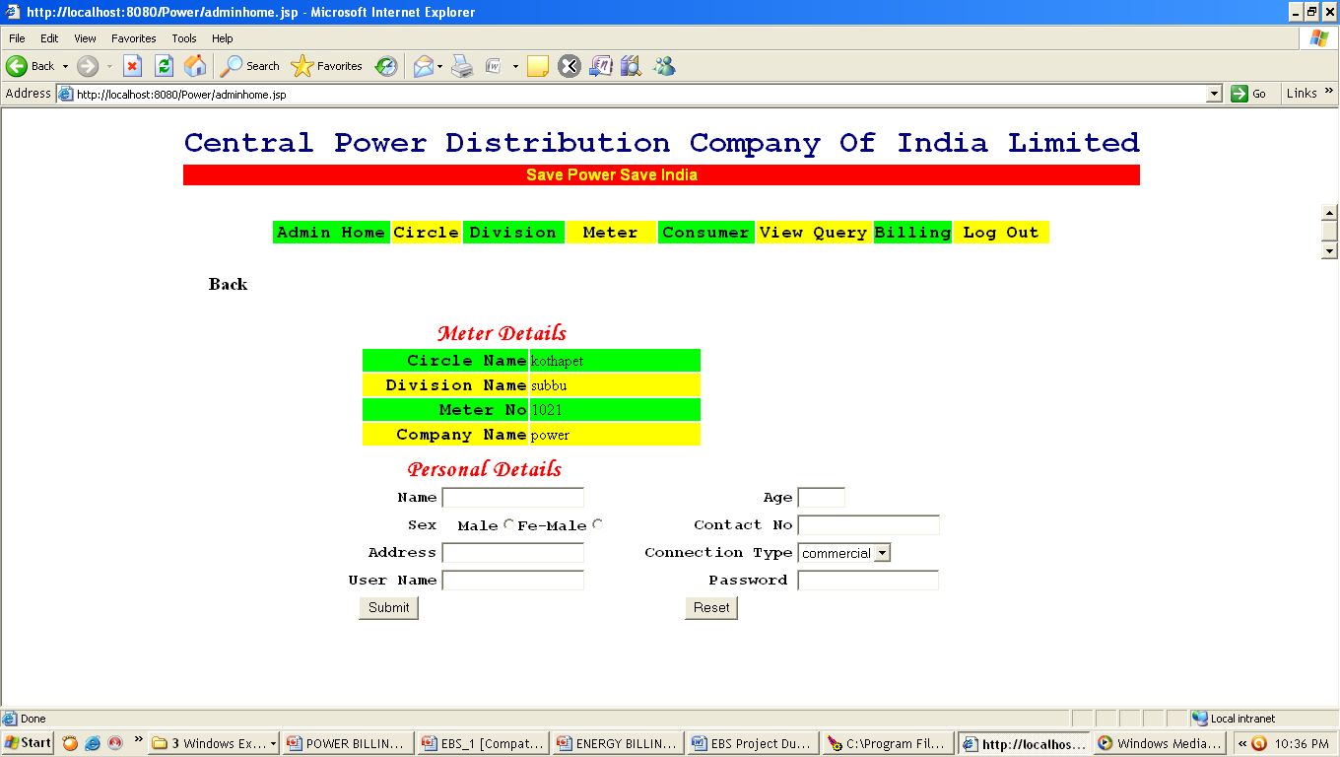

Slide 30
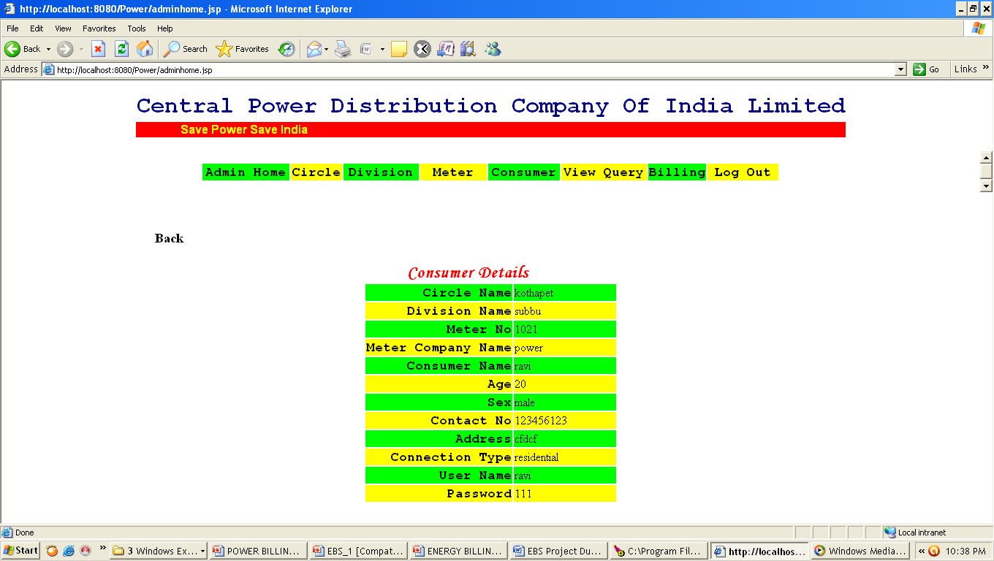

Slide 31
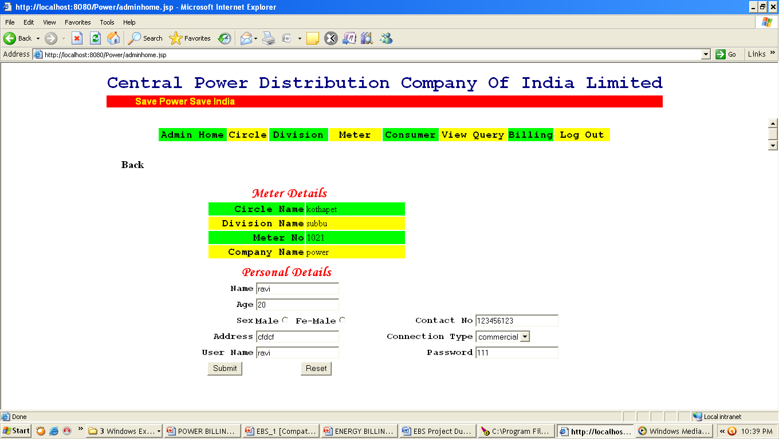

Slide 32
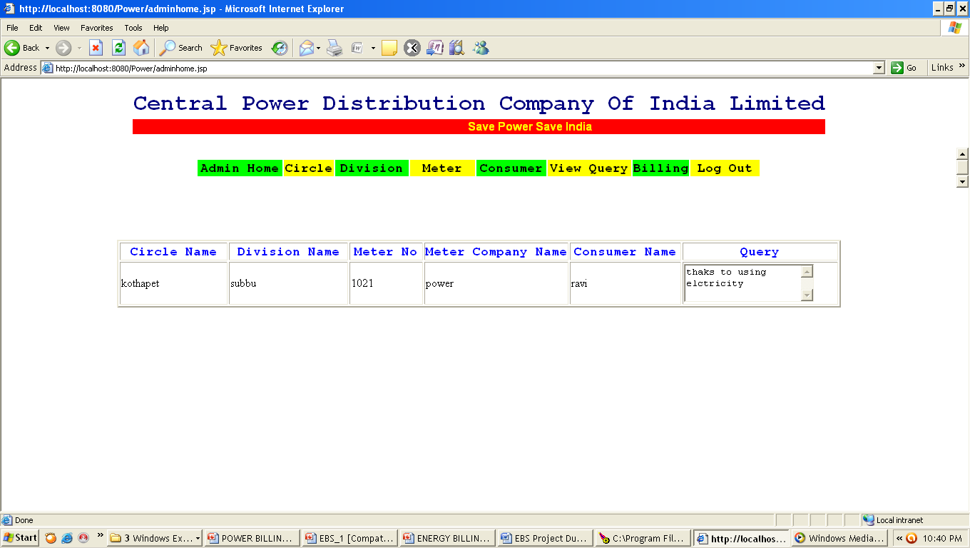

Slide 33
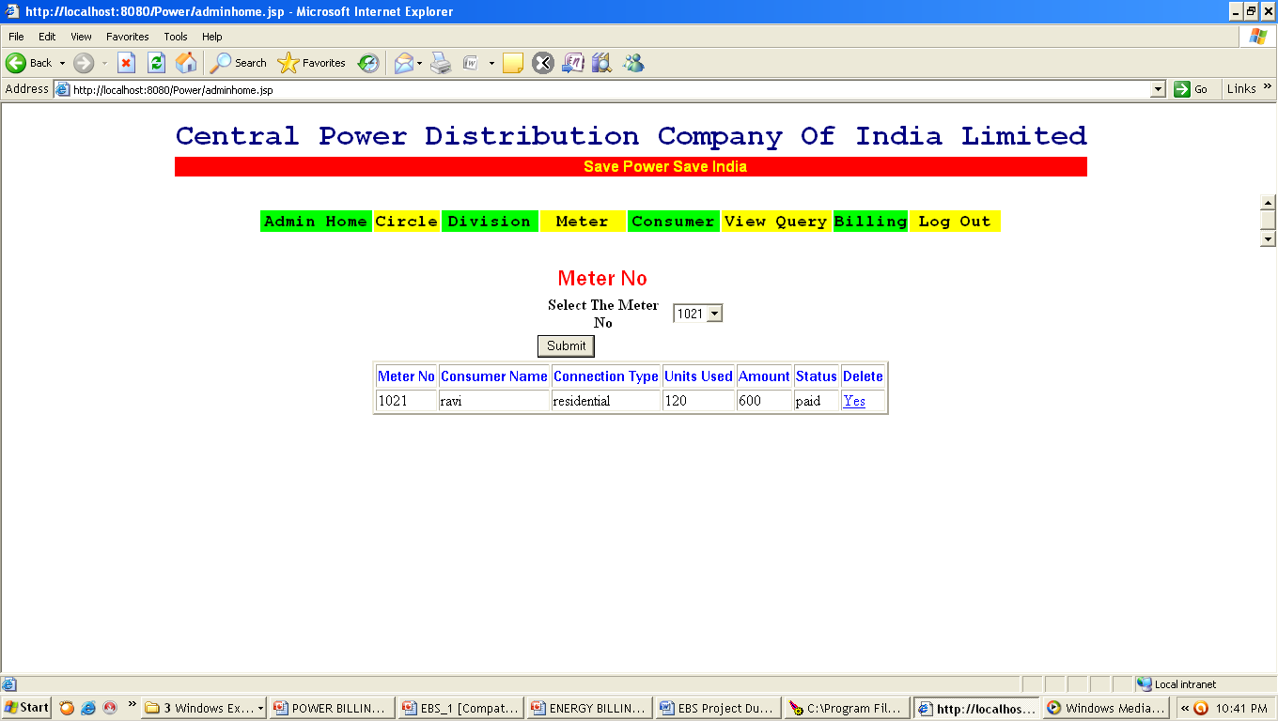

Slide 34
CONCLUSION
We have been given the problem of Billing of Electricity Consumers in APCPDCL at APTRANSCO. Earlier the Billing process at ERO is manually calculated by using the database small tolls and small scale packages at their desktop. In our project “ENERGY BILLING SYSTEM” we have automated the entire billing system is Online and centralized with all offices which they have in the central power distribution company limited.
In Consumer Management, I have tracked all the information of the consumer and have given the privileged modifications, changes and deletion. This information can be easily made available to all the stores throughout the APCPDCL Offices through intranet/ Internet.
As a result of this automation, manual workload is reduced and data retrieval becomes easy. This project can be helpful for centralization of information regarding the stores of CEPDCL at APTRANSCO.

Slide 35



